Slide 1

Real-Time Data Analysis Using Spark and Hadoop
Written By: Khadija Aziz, Dounia Zaidouni, Mostafa Bellafkih
VAISHNAVI PATIL B3 1911102

Slide 2

WHAT IS BIG DATA?
Big Data is defined to refer to the increased volume of data, which makes it very difficult to store, process and make analysis using classical processing tools. Big Data is characterized by 3 Vs : Volume, Variety, and Velocity.
Big Data is at use every single day, from the adoption of Internet through social networks, mobile devices, connected objects, videos, blogs and others.

Slide 3

Problem Definition
In order to ensure a reliable and a fast real-time information processing, powerful tools are essential for the analysis and processing of Big Data. Standard MapReduce frameworks such as Hadoop MapReduce face some limitations for processing real-time data of various formats.

Slide 4
Literature Review
In this paper, we highlight the implementation of the de-facto standard Hadoop MapReduce and the Apache Spark framework .
Thereafter, we conduct experimental simulations to analyze a real-time data stream using Spark and Hadoop.
Comparison of the two implementations in terms of architecture and performance with a discussion to feature the results of simulations is done.
Drawbacks of using Hadoop for real-time processing are discussed.

Slide 5

MapReduce
MapReduce is a programming model that allows parallel computing on a large amount of data using a large number of machines called Cluster or Grid (more data more machines).
MapReduce has two main functions:
A) Mapper: consists of splitting out and distributing the different data partitions.
B) Reducer: (The inverse of the Mapper function). It consists of collecting the results computed in parallel and merge them into a single global result by using a couple (key/value). The key is used during the merge to group the values (which have the same key).

Slide 6

HADOOP MAPREDUCE IMPLEMENTATION
Hadoop is an open source framework that allows distributed processing of a large amount of data through a cluster using a simple programming model. It allows applications to work on multiple nodes for big data processing.
This Photo by Unknown author is licensed under CC BY-ND.

Slide 7
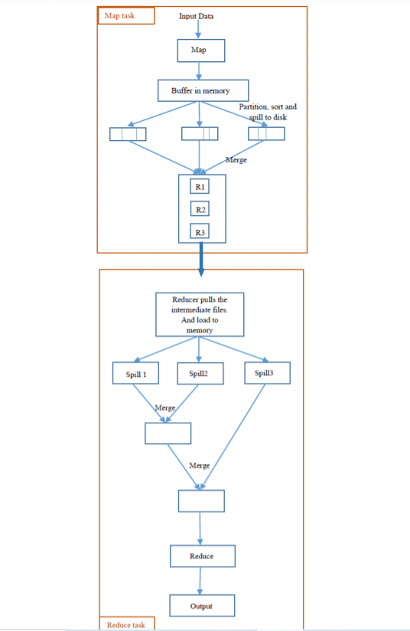
MapReduce tasks in Hadoop MapReduce
During the Map phase keys are created with an associated value in the form of (Key, Value) pairs.
Storing the output in buffer in memory
When the memory is full, the data is partitioned, sorted, and spilled onto the disk.
Combining All data into one large file according to Reducers
Data or intermediate files created by the Map phase are sorted by Reducers and loaded into the memory.
When the buffer is filled, it is spilled on the disk.
Spilling data in buffer is merged into a larger file.
During the Reduce phase, processing is performed on the merged data.

Slide 8

HDFS (Hadoop Distributed File System)
It is a distributed file system that runs on commodity hardware and provides high-performance access to data distributed in Hadoop clusters.
It is extremely fault tolerant and facilitates the rapid transfer of data between the nodes of the system. This fact helps keep Hadoop systems operational if a node breaks down.
Additionally, this mechanism reduces the risk of a critical failure, even if the failure involves several nodes.
This Photo by Unknown author is licensed under CC BY.

Slide 9

APACHE SPARK IMPLEMENTATION
Apache Spark is an open source processing engine that is highly fast and reliable . It was essentially designed for fast computing.
This system provides APIs (Application Programming Interface) in different programming languages such as Scala, Java and Python.

Slide 10

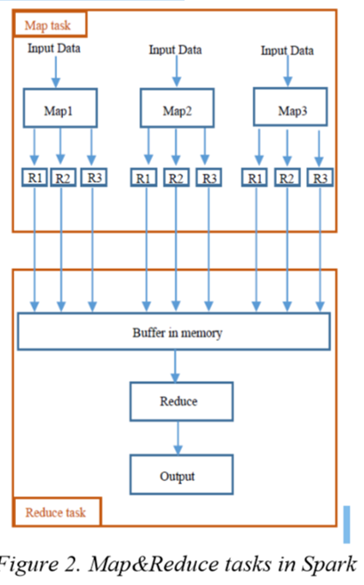
MAPREDUCE TASKS IN SPARK
Although Spark is not a MapReduce framework, it can perform similar operations
Writing the output of the Map phase in the OS buffer cache
Deciding if the data will remain in-buffer, in-memory or will be spilled on the disk
Writing the Data to the Reduce memory.
Processing the data by the Reduce function.
This Photo by Unknown author is licensed under CC BY-SA.

Slide 11

EXPERIMENTAL EVALUATION AND RESULTS
In the experimental study, the authors have retrieved, the Twitter data (as twitter is a very important source of data) for analysis with Apache Spark and Hadoop MapReduce.
This Photo by Unknown author is licensed under CC BY-SA.

Slide 12
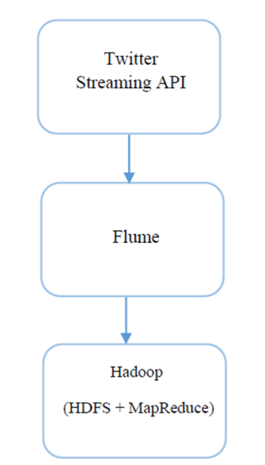
Hadoop MapReduce
Architecture of processing data in Hadoop MapReduce

Slide 13
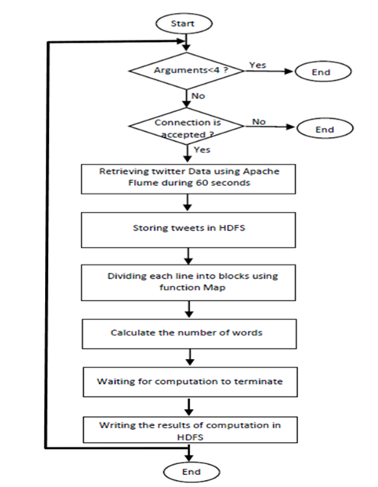
Workflow of processing data in Hadoop MapReduce

Slide 14
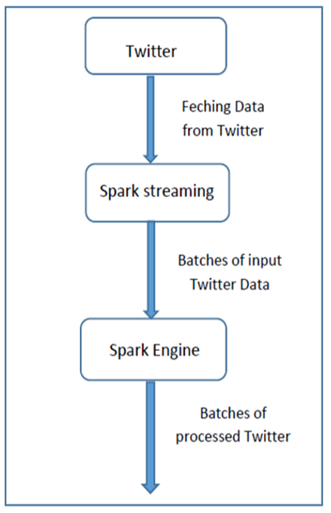
Apache Spark
Proposed Architecture:

Slide 15
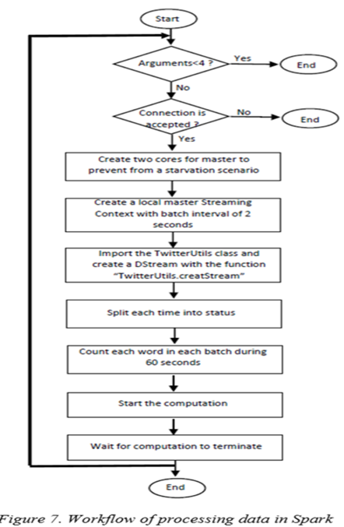
Workflow of processing data in
SPARK

Slide 16

Experimental Setup
In this experiment, they developed a program in Scala language to show the reception rate of the twitter data and also the processing time of batches. They show how Spark processes Twitter Data in some seconds.

Slide 17


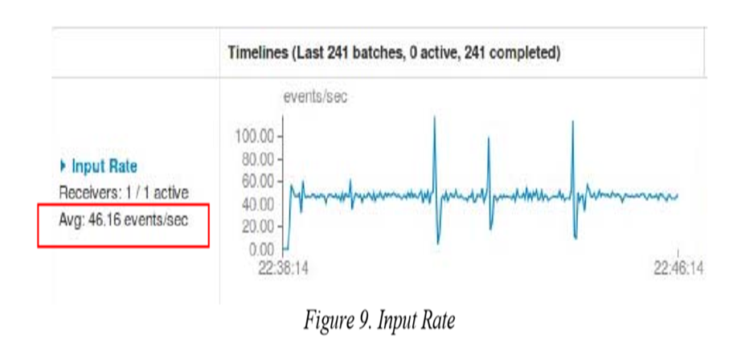
Figure 9 shows the diffusion of the Streaming application. The input rate means that the application receives data at a rate of about 46 events per second.

Slide 18
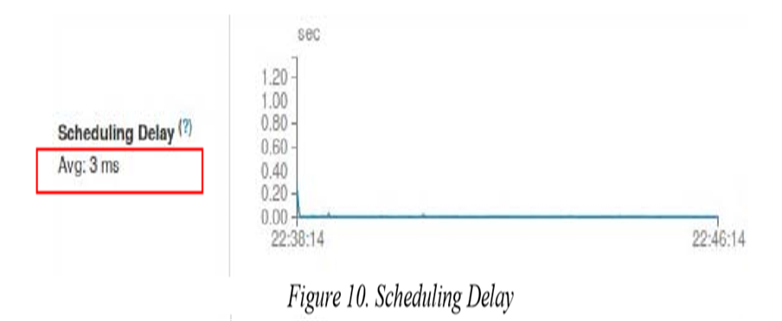
Figure 10 shows the Scheduling Delay, which defines the waiting time of a new batch processing for that the preceding batches are completed (to start another batch). This Scheduling Delay must be absolutely too small for the batch to be processed quickly (from its creation).

Slide 19
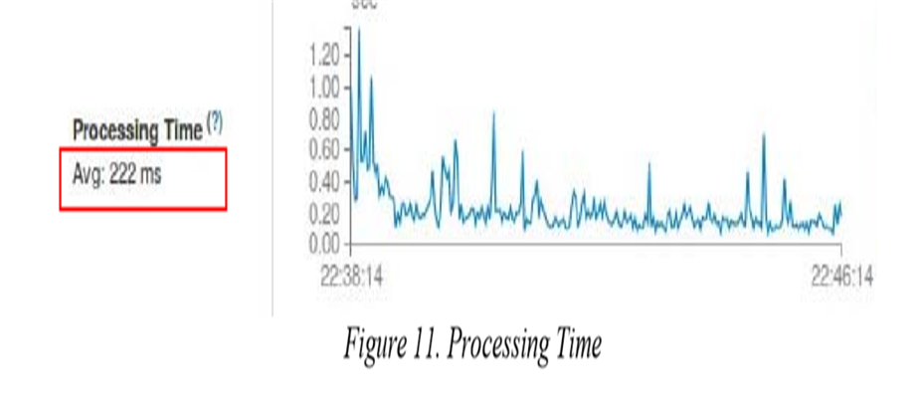
Figure 11 shows that the batches are processed within 222 ms on average processing, this average is smaller than the batch interval. This means that the treatment is in good state.

Slide 20
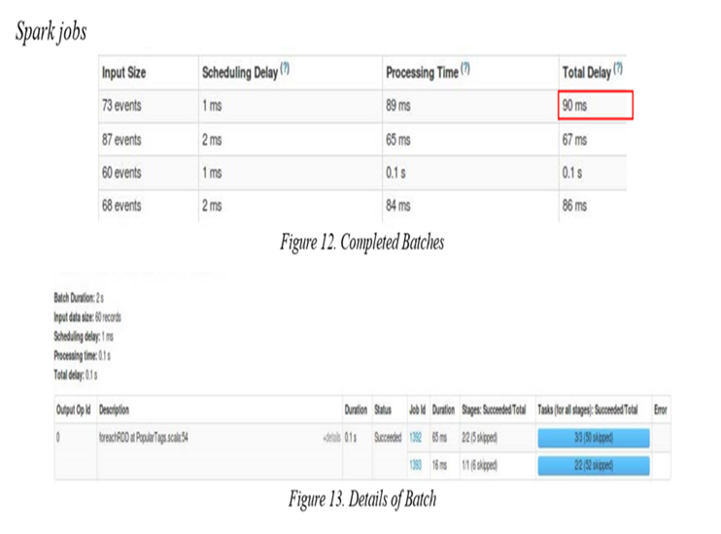
It is noted that some batches have taken a long time to finish. So, to have more details on the batch and to know the reason of processing delay of these batches, it is enough just to click on the Batch Time which has long processing time as shown in figure 13. This figure shows the duration and the status as well as the jobs generated (in our case 2 jobs generated).

Slide 21
COMPARISON BETWEEN SPARK AND HADOOP
HADOOP | SPARK
Memory bandwidth utilization is not that good. | Better memory bandwidth utilization
Hadoop employs heartbeat for tracking tasks, which periodically causes a few seconds delays. | In Spark, task scheduling is based on an event-driven mode
Hadoop MapReduce uses batch processing, so it needs to analyze the data step by step. | Spark processes the data in memory only once.
Uses the MapReduce algorithm for data processing, this algorithm reads and writes from disk which makes the processing speed of MapReduce slower. | Reduces the read/write cycle on disk and stores intermediate data in memory that is why it can process up to 100 x faster in memory and 10 x faster on disk
Hadoop MapReduce is relatively slower, because it is designed to do batch processing on a large amount of data and varied formats. | Apache Spark adopts micro-batch processing, that is why it is faster than Hadoop MapReduce.

Slide 22

CONCLUSION
As obtained in our experimental setup, Spark analyzed the tweets in a small period of time which is less than a second, this prove that Spark is a good tool for processing streaming data in real-time.
Spark is a high quality tool for memory processing that allows processing streaming data in real-time on a large amount of data. Apache Spark is much more advanced than MapReduce. It supports several requirements like real-time processing, batch and streaming.

Slide 23
REFERENCES
[1] Gunarathne, T. (2015). Hadoop MapReduce v2 Cookbook. Packt Publishing Ltd.
[2] Dean, J., & Ghemawat, S. (2010). MapReduce: a flexible data processing tool. Communications of the ACM, 53(1), 72-77.
[3] Hadoop, https://hadoop.apache.org/docs/r1.2.1/hdfs_design.html
[4] Patel, A. B., Birla, M., & Nair, U. (2012, December). Addressing big data problem using Hadoop and Map Reduce. In 2012 Nirma University International Conference on Engineering (NUiCONE) (pp. 1-5). IEEE.
[5] Databricks, https://databricks.com/spark/about
[6] Spark, http://spark.apache.org/
[7] Karau, H., Konwinski, A., Wendell, P., & Zaharia, M. (2015). Learning spark: lightning-fast big data analysis. " O'Reilly Media, Inc.".
[8] Spark, https://spark.apache.org/docs/1.6.0/spark-standalone.html
[9] Spark, https://spark.apache.org/docs/1.6.0/running-on-yarn.html
[10] Spark http://databricks.github.io/simr/
[11] Tweets, http://www.internetlivestats.com/twitter-statistics/
[12] J. Dean and S. Ghemawat. Mapreduce: simplified data processing on large clusters. Commun. ACM, 51(1):107–113, 2008.
[13] Liu, X., Iftikhar, N., & Xie, X. (2014, July). Survey of real-time processing systems for big data. In Proceedings of the 18th International Database Engineering & Applications Symposium (pp. 356-361). ACM.
[14] Zaharia, M., Xin, R. S., Wendell, P., Das, T., Armbrust, M., Dave, A., ... & Ghodsi, A. (2016). Apache spark: a unified engine for big data processing. Communications of the ACM, 59(11), 56-65.

Slide 24

Implementation Strategy
My main objective would be to work on processing live tweets for Analysis using Spark Streaming APIs
I will use Twitter APIs to stream tweets in real time
Route tweets coming from twitter API to the TCP server using SocketStream

